Slide 1

KANSAS CITY CRIME DATA ANALYSIS
Vishnu Datta
Swathi Reddy
Pawan Kumar
Abhinayani

Slide 2
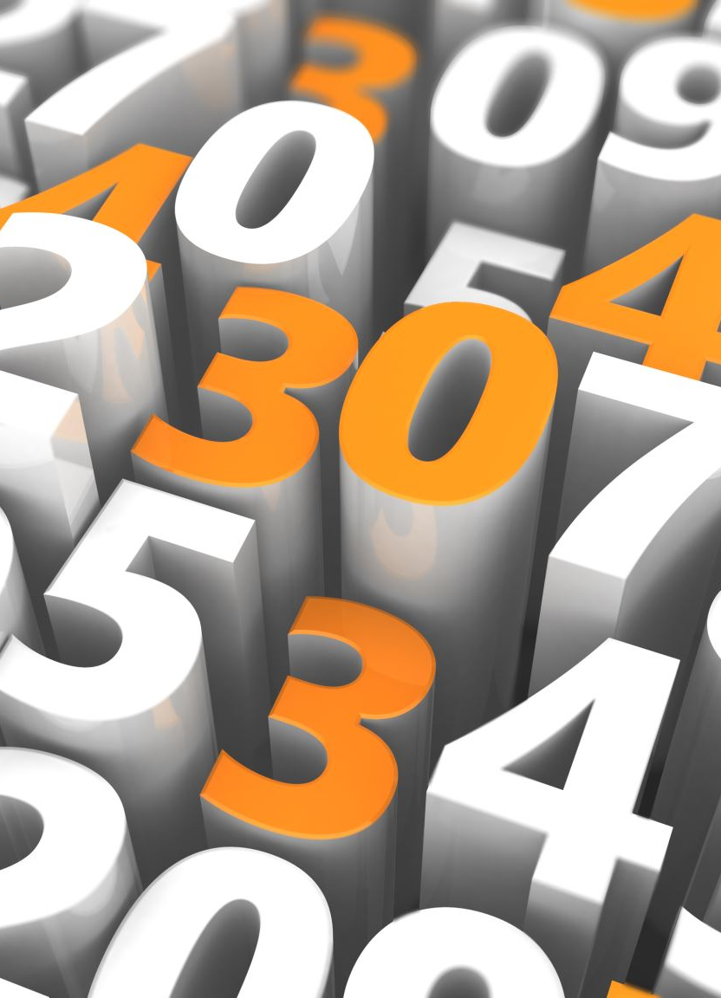
ABSTRACT
Crime is one of the biggest and dominating problems in our society and its prevention is an important task.
Daily there are huge numbers of crimes committed frequently. This requires keeping track of all the crimes and maintaining a database for the same which may be used for future reference.
The current problem faced is maintaining a proper dataset of crime and analyzing this data to help in predicting and solving crimes in the future.

Slide 3

OBJECTIVE
To analyze the crime data of Kansas city.
Understand the applications of crime analysis.
Be exposed to how crime analysis can be used to solve community problems
and getting advanced crime analysis

Slide 4
DATA SET
We have collected the data set from https://data.kcmo.org/browse?category=Crime
The data set has 4 lakh rows and 23 Columns.
Has around six years worth of crime reporting just for Kansas city.
We used this dataset to create a basic analysis architecture so
when we extend this to the combined data of all the other cities in US,
it will be able to adapt to the big data.

Slide 5

FEATURE ENGINEERING
Removing some unwanted features.
Adding new columns.
Cleaning the rest.

Slide 6

TEAM COLLABORATION
Each of us worked on same dataset to maximize the analysis.
The results and analysis of our individual contribution have been summed up in the report.

Slide 7
APPLICATIONS/IDE USED
The jupyter notebook is an open-source IDE.
The jupyter notebook is the original web application for creating
and sharing computational documents.
Python is the requirement for installing the jupyter notebook.

Slide 8
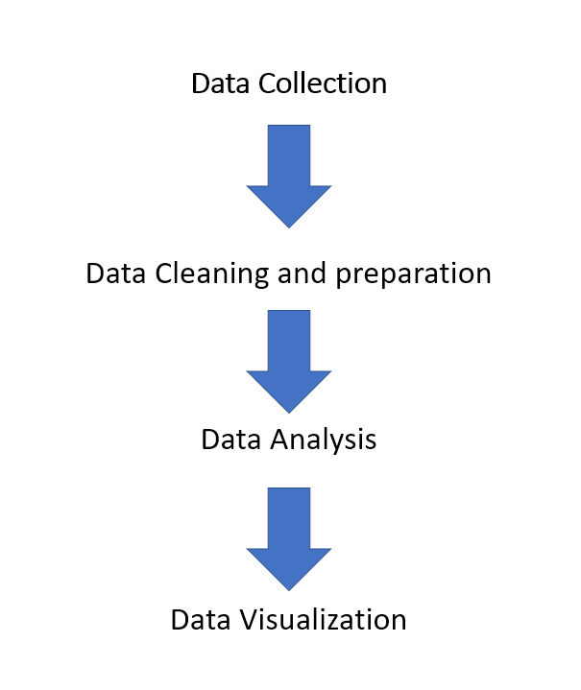
The below are the steps followed

Slide 9
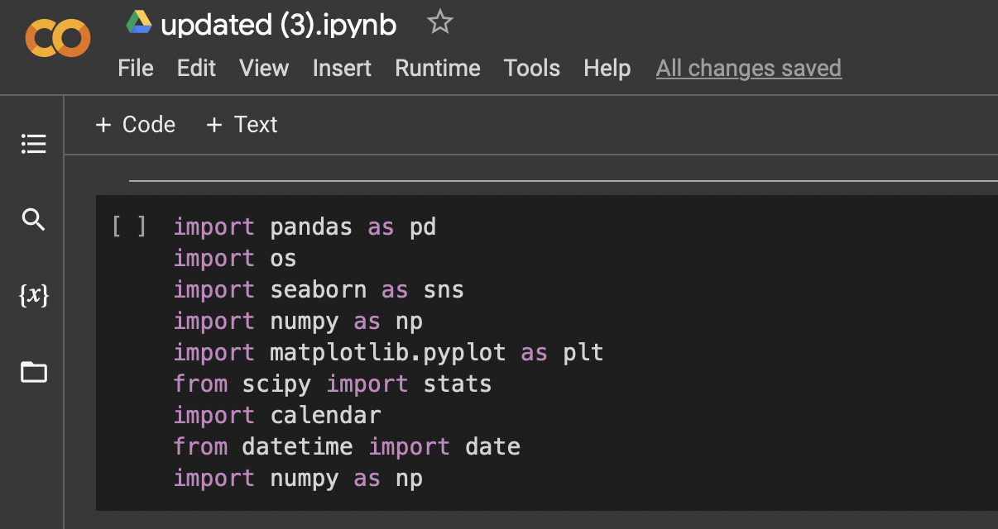
MODULES USED:

Slide 10
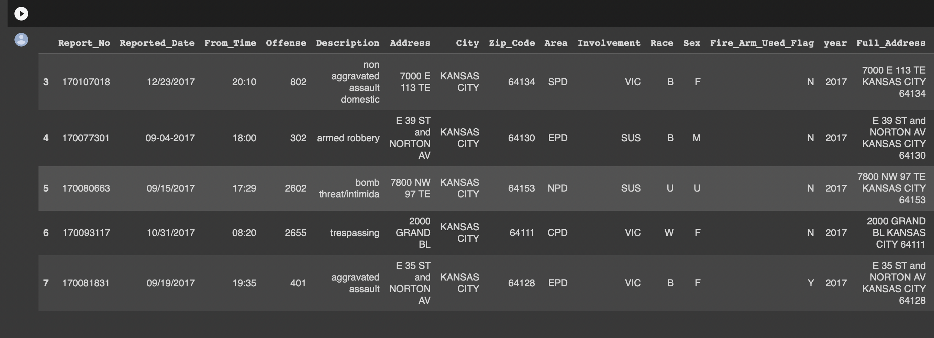
SAMPLE DATASET:

Slide 11
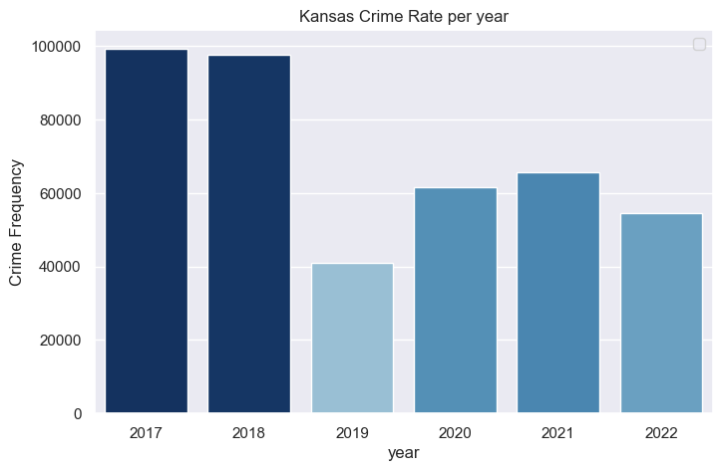
KANSAS CITY CRIME RATE: YEAR VS CRIME FREQUENCY:

Slide 12
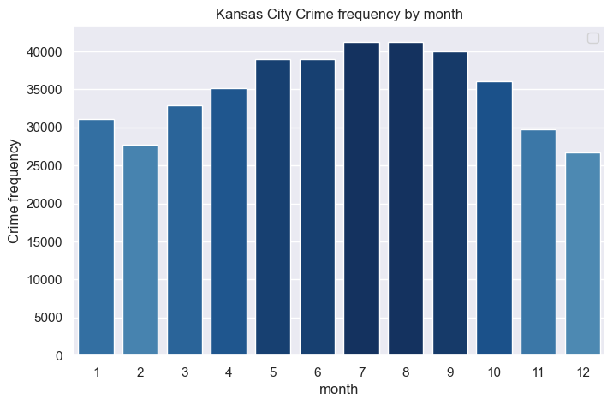
MONTH VS CRIME FREQUENCY
From the above figure, we can understand that
there was a rise in crime rate in the month of July and August.
And least crime rate were recorded in the
months of February and December.

Slide 13
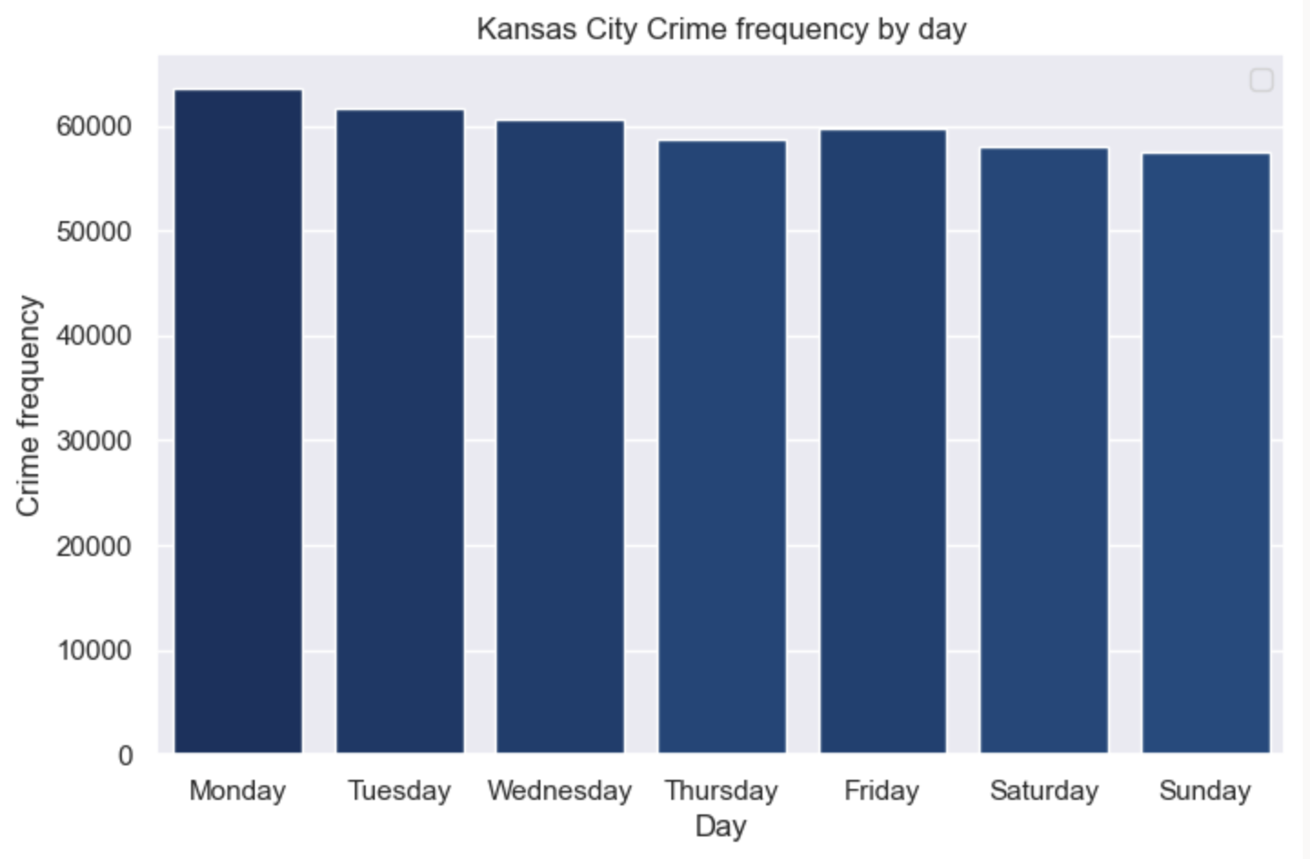
DAY VS CRIME FREQUENCY
We can conclude that the most number of
crimes were committed on Monday

Slide 14
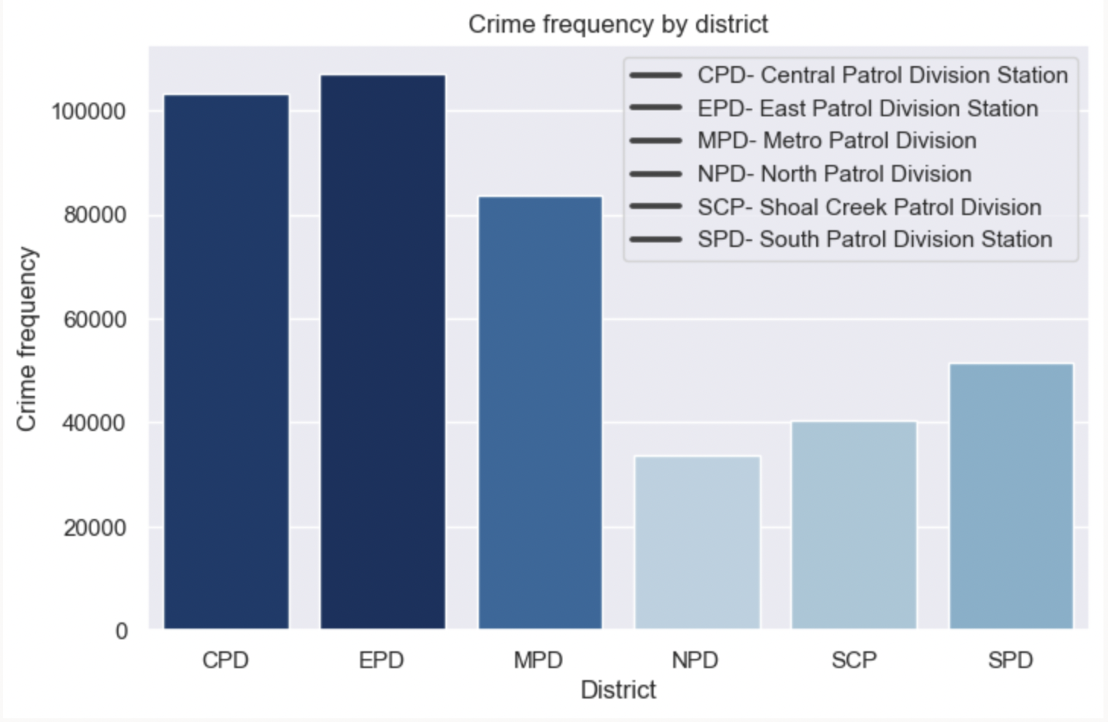
DISTRICT VS CRIME FREQUENCY
NPD, SCP AND SPD have low
Crime records, so, we can presume that they are safe places

Slide 15
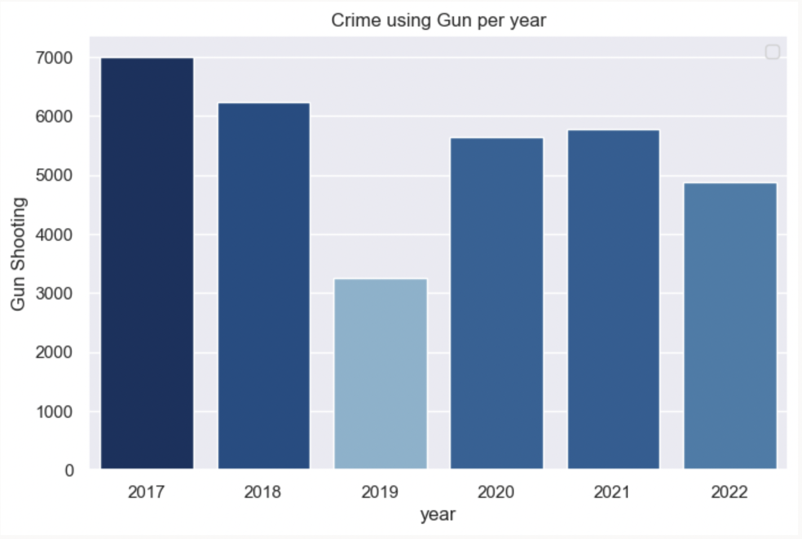
YEAR VS GUN SHOOTING
The above figure illustrates that the most shooting happened in the year 2017 and the least was in the year 2019

Slide 16
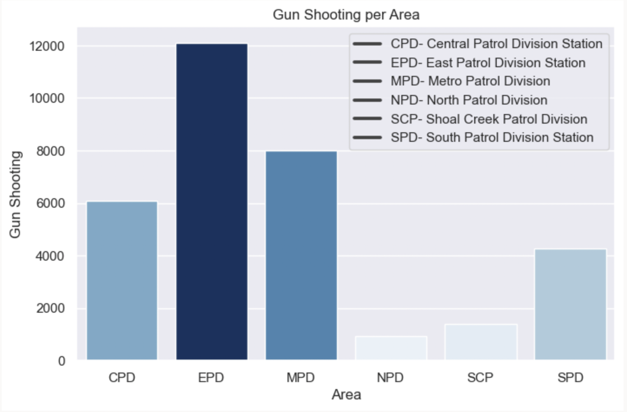

AREA VS GUN SHOOTING
The above figure concludes that more number of shooting occurred in EPD Area.

Slide 17
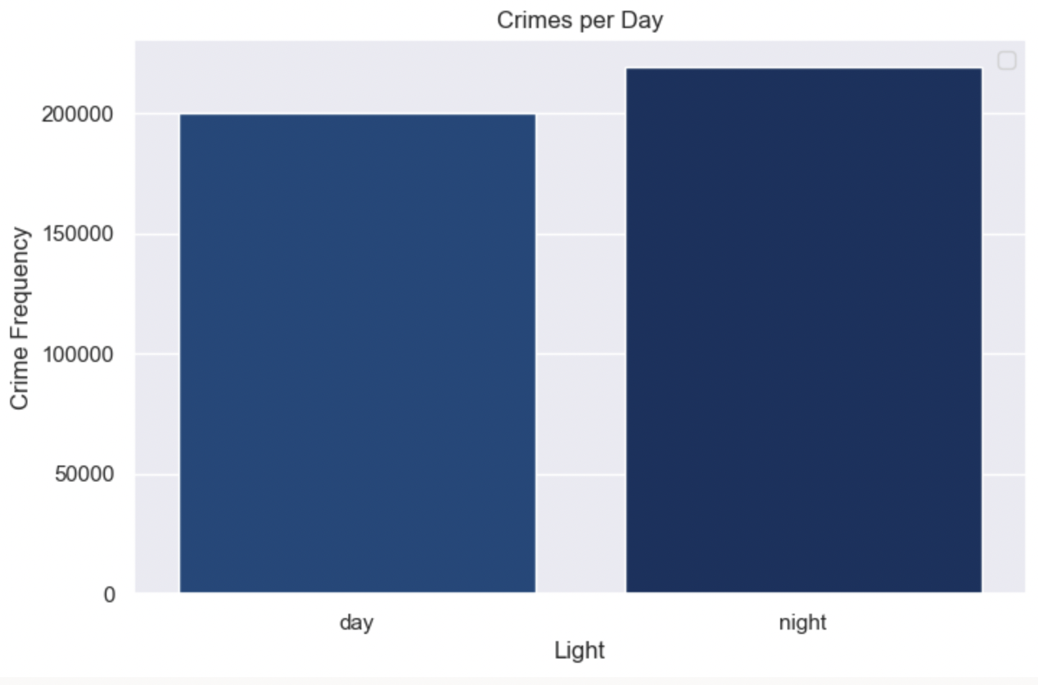
LIGHT VS CRIME FREQUENCY
From the above graph, we can say that crimes were mostly done at night.

Slide 18
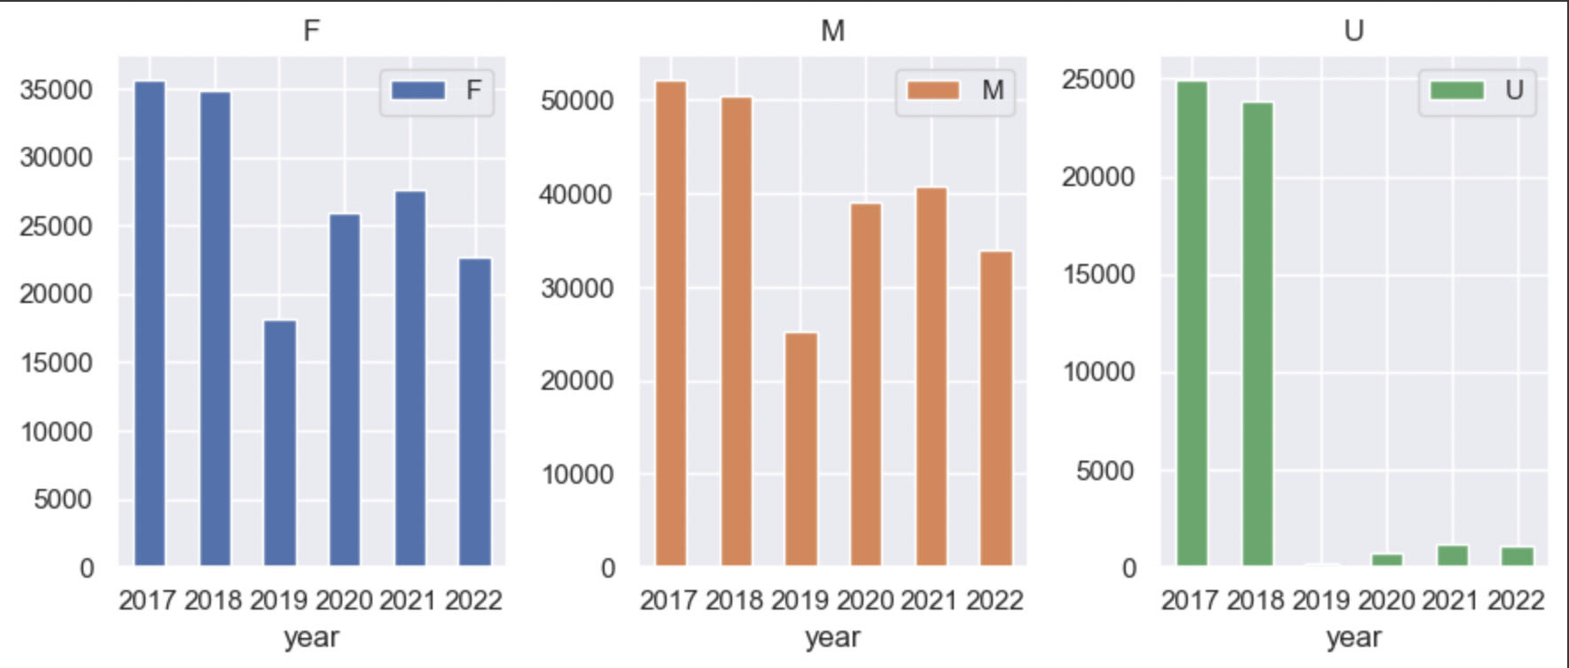
CRIME ANALYSIS USING GENDER AND YEAR
The above graphs defines the involvement of Male and Female in the crime.
We can observe that the most number of crimes were committed by male and female in the year 2017.

Slide 19
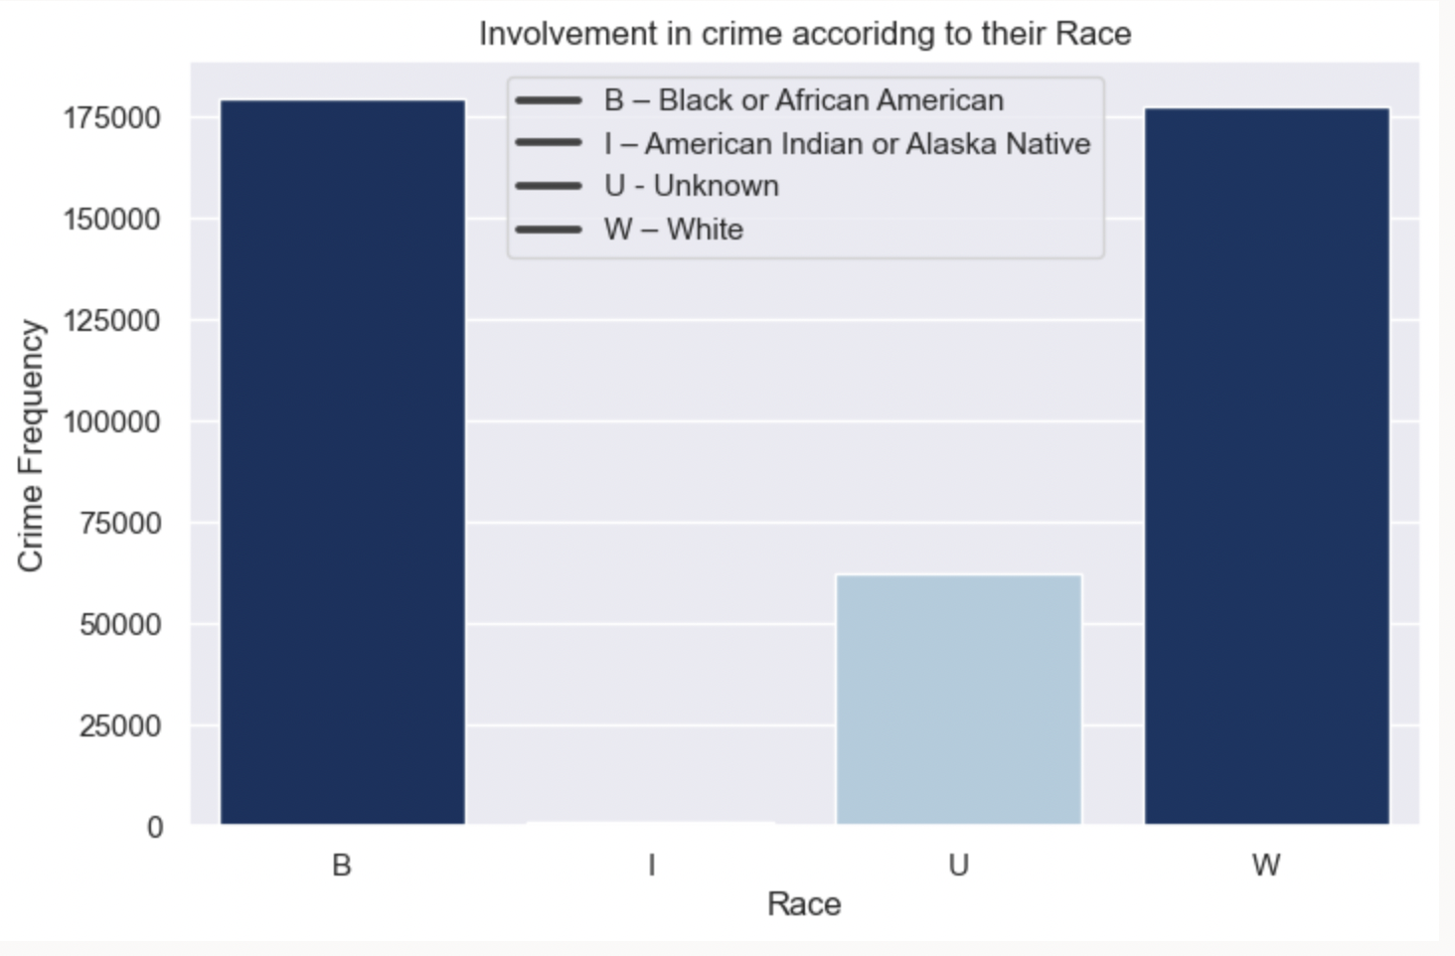
RACE VS CRIME FREQUENCY
From the side graph we can notice that Black or African Americans are involved in most crimes happened

Slide 20
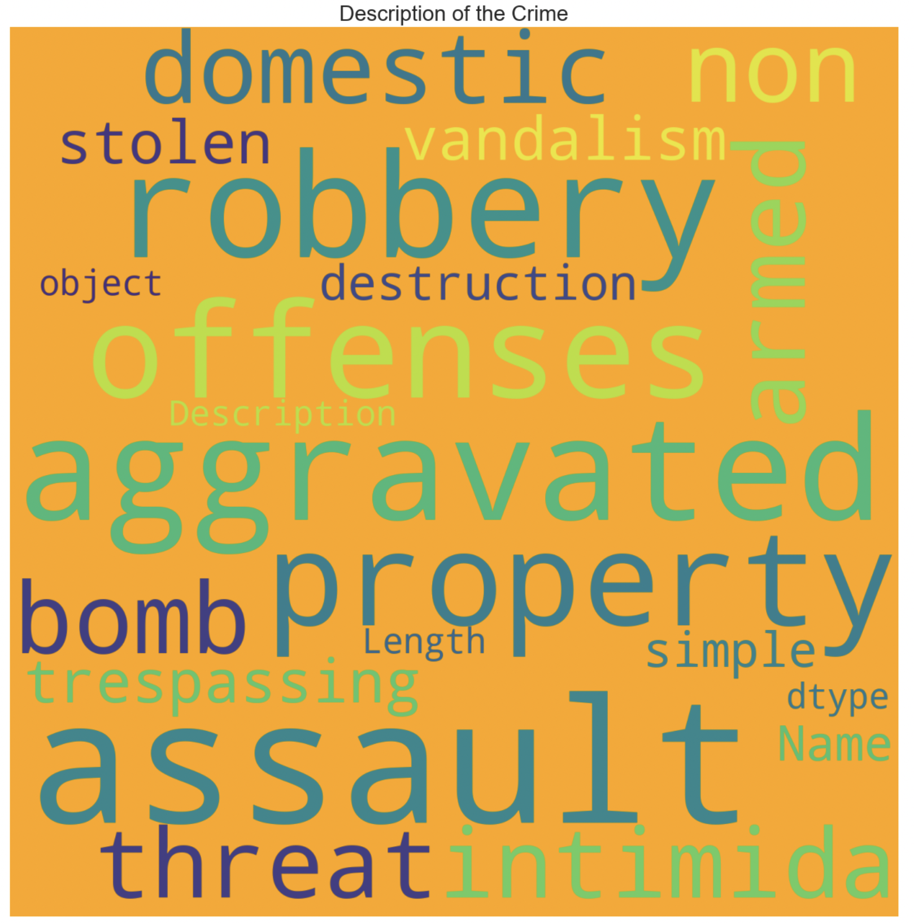
FREQUENCY OF CRIMES USING WORD COUNT
These are the most frequently committed crimes in Kansas city.

Slide 21
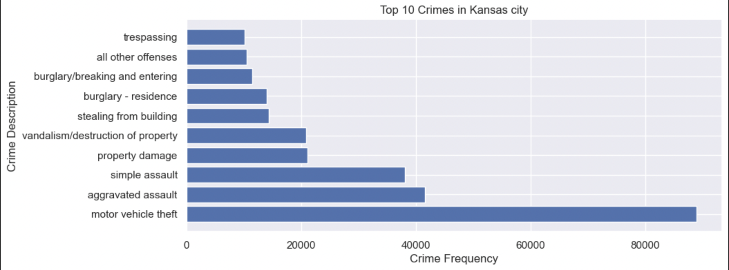
ANALYSIS OF TOP 10 CRIMES IN KANSAS CITY
From the above analysis, we can observe that motor vehicle theft is the frequently committed
crime in Kansas City

Slide 22
FUTURE SCOPE
In the future, we can predict the type of crime that might occur based on the input
features in the dataset.

Slide 23

THE END

